Slide 1
3-way and 4-way Switch

Slide 2
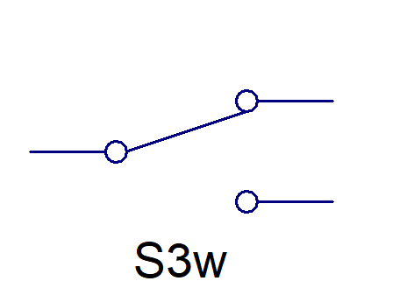
3-Way Switch
A 3-way switch is larger than a single pole switch and has three screw terminals for wiring connections, plus a ground. Two of these take traveler wires that go from one switch to the other. For the third terminal, one switch is connected to the hot supply wire while the other switch is joined to the light.

Slide 3
3-Way Switch
1 = Traveler
0 = Common
2 = Traveler

Slide 4
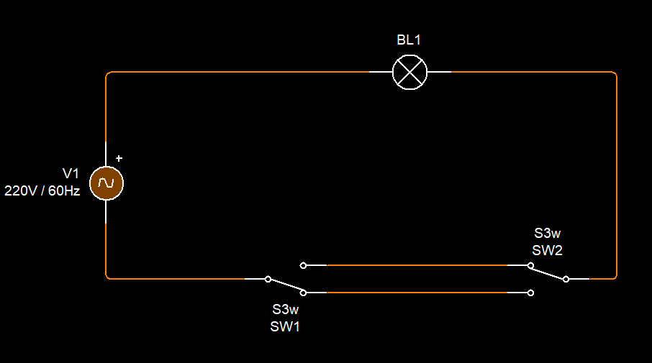
3-Way Switch Connection

Slide 5
3-Way Switch Main Function
A 3-way switch main function is to switch on/off a load/output components in two different location

Slide 6
4-way Switch

Slide 7
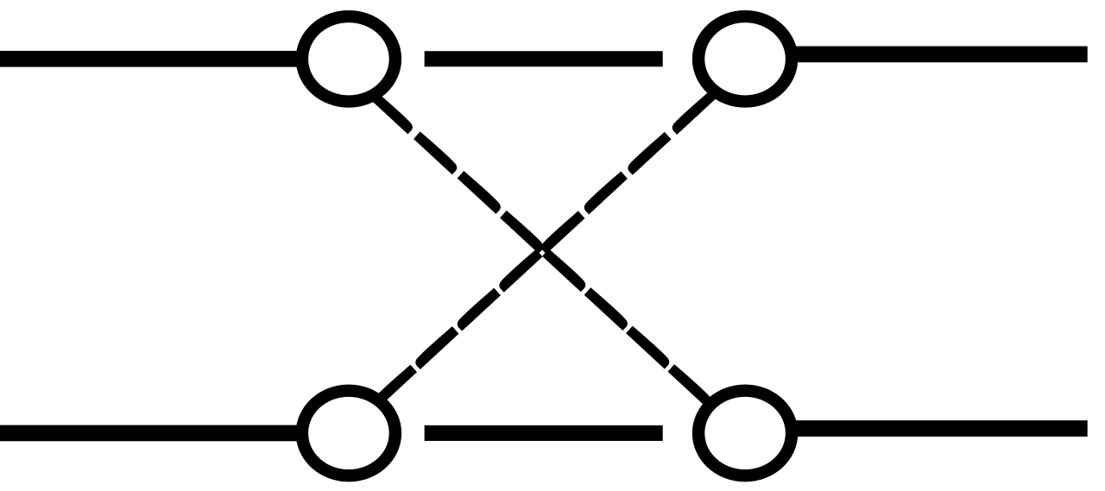
4-Way Switch
A 4-way SWITCH IS A FOUR TERMINAL SWITCH THAT NEEDS TWO 3 WAY SWITCH.

Slide 8
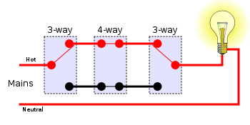
4-Way Switch Connection

Slide 9
4-Way Switch MAIN FUNCTION
A 4-way SWITCH MAIN FUNCTION IS TO SWITCH ON/OFF A LOAD IN THREE OR MORE LOCATION.

